Slide 1
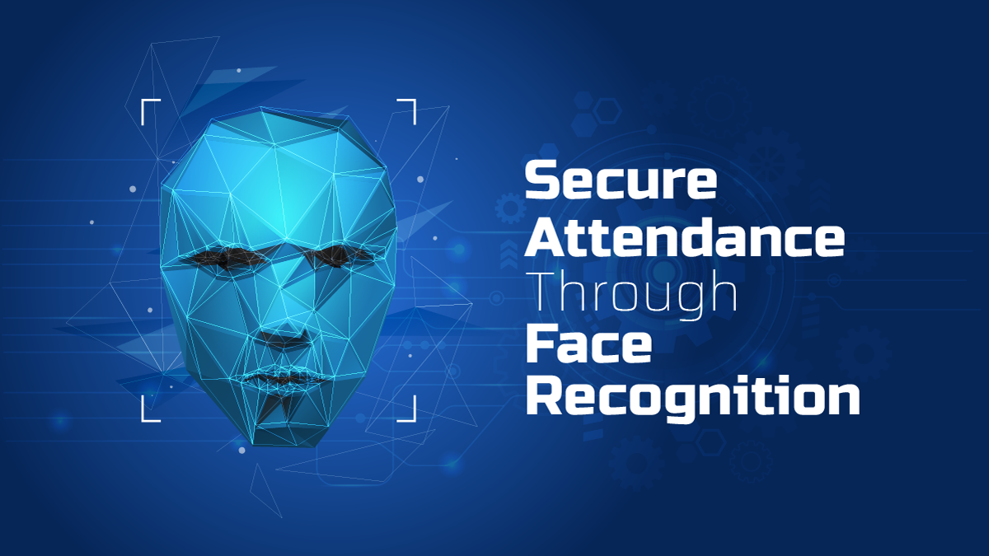

Slide 2
Table of Content
Introduction
Motivation
Used python Libraries
Django Framework
Use case of our Web Application
How the face recognition is working
Applications
Conclusion

Slide 3
Face Recognition
Face recognition is a biometric technology that uses a person's face to identify them in photos, videos, or in real-time. It works by analyzing the patterns and shapes of faces to create a unique template, or facial data, which can be used to identify people. The software then compares the facial features in the photo or video to the stored face print in order to verify the individual's identity

Slide 4
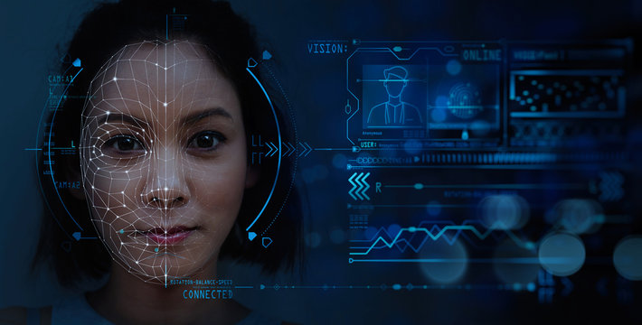
Facial recognition typically looks for the following facial landmarks
Distance between the eyes
Distance from the forehead to the chin
Distance between the nose and mouth
Depth of the eye sockets
Shape of the cheekbones
Contour of the lips, ears, and chin

Slide 5
Motivation
Connecting the world digital Identification
Enhanced security measures
Improving convenience in authentication process
Enabling personalizes user experience

Slide 6
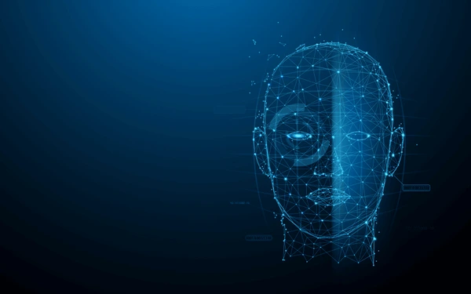
Used Python Libraries for face recognition :
opencv-python
face_recognition

Slide 7
OpenCV Python Library
OpenCV (Open Source Computer Vision Library) is a free, open-source library that includes hundreds of computer vision algorithms. It is used for image processing and computer vision tasks such as face recognition, object detection, and motion tracking. OpenCV has a Python interface, making it easy to use for Python developers.

Slide 8
Application of OpenCV
Python Library
Image processing:
OpenCV Python library can be used for image processing tasks such as image resizing, filtering, and edge detection.
Computer vision:
OpenCV Python library can be used for computer vision tasks such as face recognition, object detection, and motion tracking.
Machine learning:
OpenCV Python library can be used for machine learning tasks such as image classification and object segmentation.

Slide 9
Face_recognition
Python library
The face_recognition library in Python is a facial recognition library that can recognize and manipulate faces. It's built using dlib's face recognition algorithm. This library can perform a large number of tasks.
The face_recognition library is a simple user interface for face detection and recognition tasks. It provides a face_locations() method that locates all faces in an image or video frame and gives their bounding box coordinates. It also provides a compare_faces() method that compares two faces and returns a Boolean value indicating whether they are the same person.

Slide 10

Required Python Libraries
asgiref==3.7.2
attrs==23.2.0
click==8.1.7
cmake==3.28.3
colorama==0.4.6
Django==5.0.3
django-autoslug==1.9.9
face-recognition==1.3.0
face_recognition_models==0.3.0
jsonschema==4.21.1
jsonschema-specifications==2023.12.1
numpy==1.26.4
opencv-python==4.9.0.80
pillow==10.2.0
pyproject-toml==0.0.10
referencing==0.34.0
rpds-py==0.18.0
sqlparse==0.4.4
toml==0.10.2
tzdata==2024.1

Slide 11
Django Python Framework
Django is a free, open-source Python framework that helps developers build web applications quickly. Django's Model-View-Controller (MVC) architecture allows developers to change an application's business logic and visual components independently. Django is also known as the "batteries included" framework because it provides built-in features, such as a default database and Django Admin Interface.

Slide 12

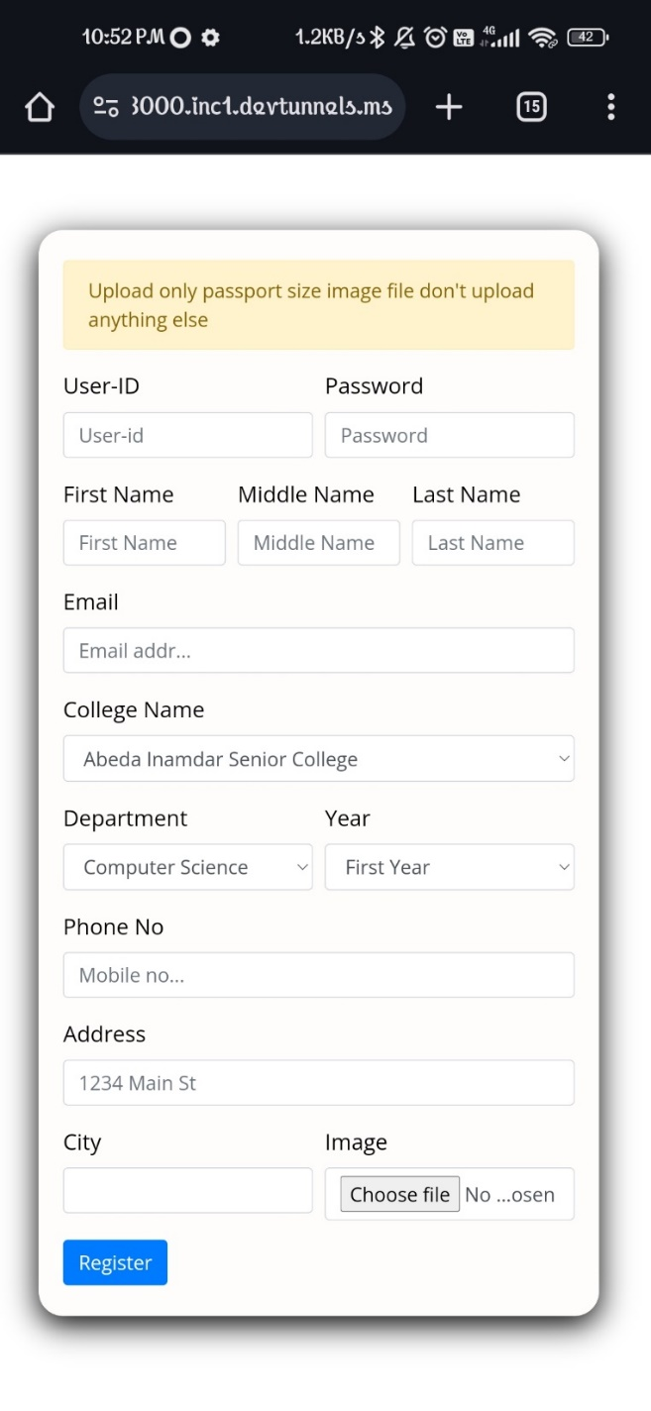
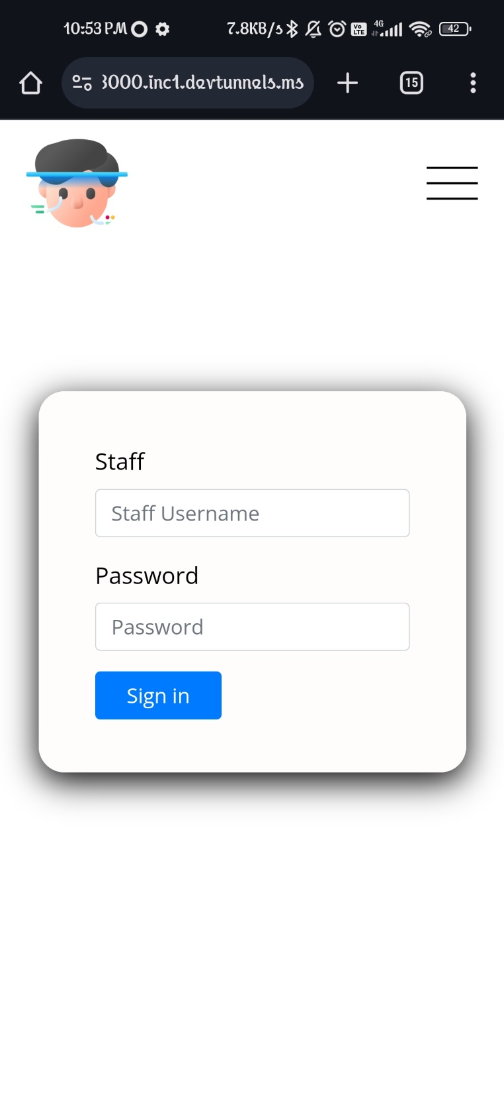
Use case of our Web Application
Step 1: Student or Employees will register them self
Step 2: Security Guard or Bouncers will login with the provided credentials by company or institute admin

Slide 13
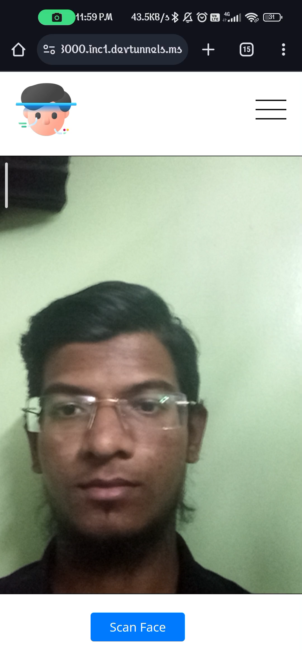
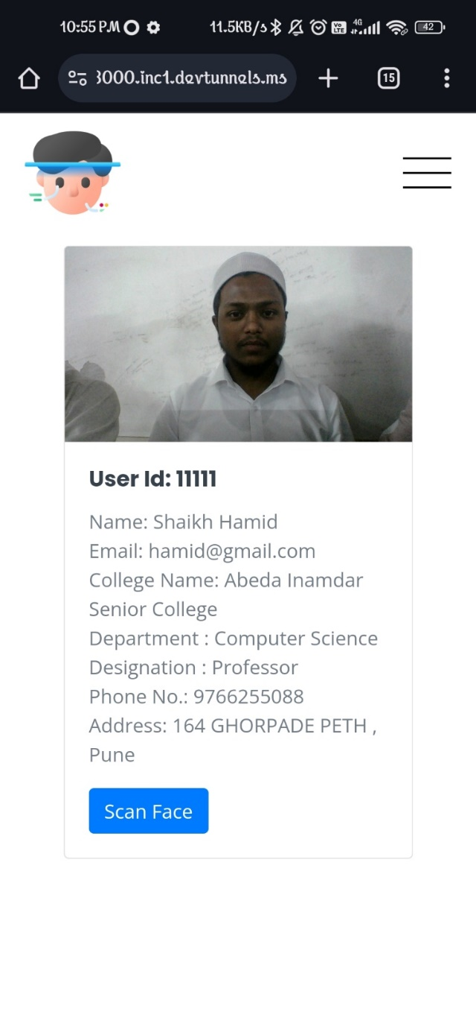
Step 3: Security Guards will be redirected to there profile where they found scan face button to scan the faces
Step 4: Security Guards will scan the faces of Employees or Students

Slide 14
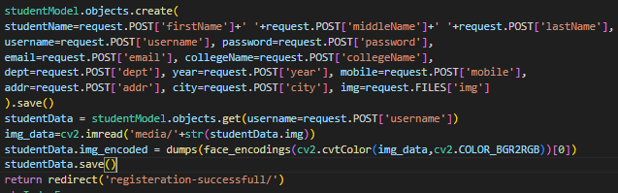
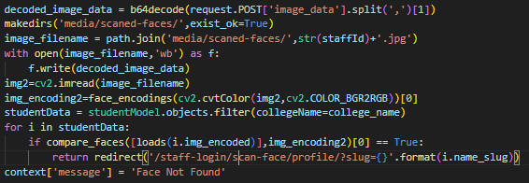
How the face recognition is working
Step 1: Fetching student’s image at the time of Registration.
Step 2: Getting the coordinates of faces from the image & storing them in the binary from
Step 3: At the time of Scanning we are fetching there live image & got coordinate from it
Step 4: We are comparing the live coordinates with all the stored company/institute face coordinates
Step 5: If coordinate got matched the profile of that employee or student will be displayed
Else ‘Face Not Found’ message will be displayed

Slide 15
Applications
Securely Authenticating using face
Giving access to only authorized people to go in critical places like CCTV surveillance room, server rooms etc.
Authenticating People by there faces

Slide 16
Conclusion
Authenticating the people by there faces will increase the security & best solution of proxies.
By registering there company to our website any company can use it for there employees attendance.
It doesn’t need any hardware just the thing it need a smartphone.
By using our website recognizing people by there faces becomes more easier

Slide 17
Thank You
Developer
Shaikh Faizan Abdul Kadar
From Abeda Inamdar Senior College

